Slide 1
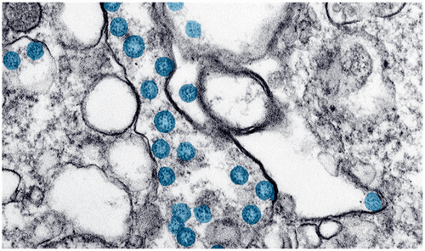
Approach to COVID- 19 Illness, Battle against invisible Enemy
Quazi Tarikul Islam
Professor of Medicine
Member, National Technical Advisory Committee on COVID-19
prof.tarik@gmail.com

Slide 2


Notes:
Total death of Bangladeshi doctor 56

Slide 3



Slide 4



Slide 5
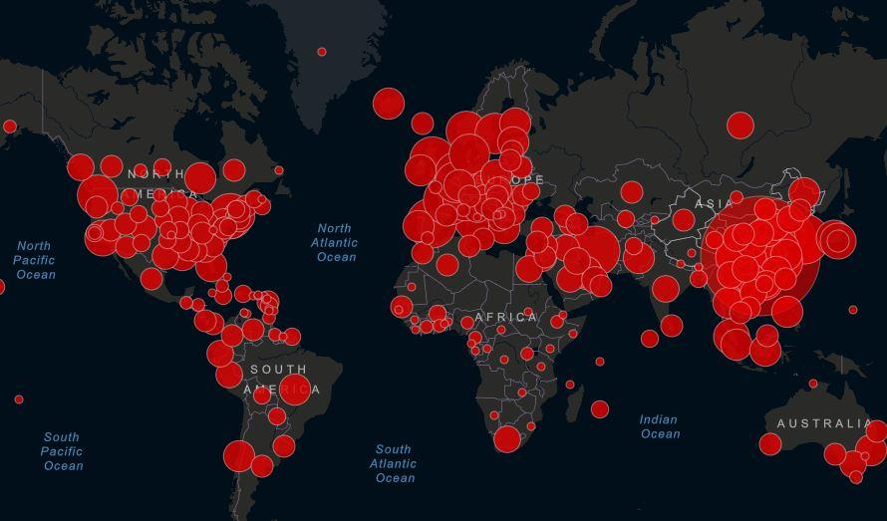
Global situation

Slide 6
Introduction
COVID-19 is
the pandemic disease
which is potentially severe acute
respiratory infection
caused by a novel evolving severe acute
respiratory syndrome coronavirus 2 (SARS-CoV-2)

Slide 7
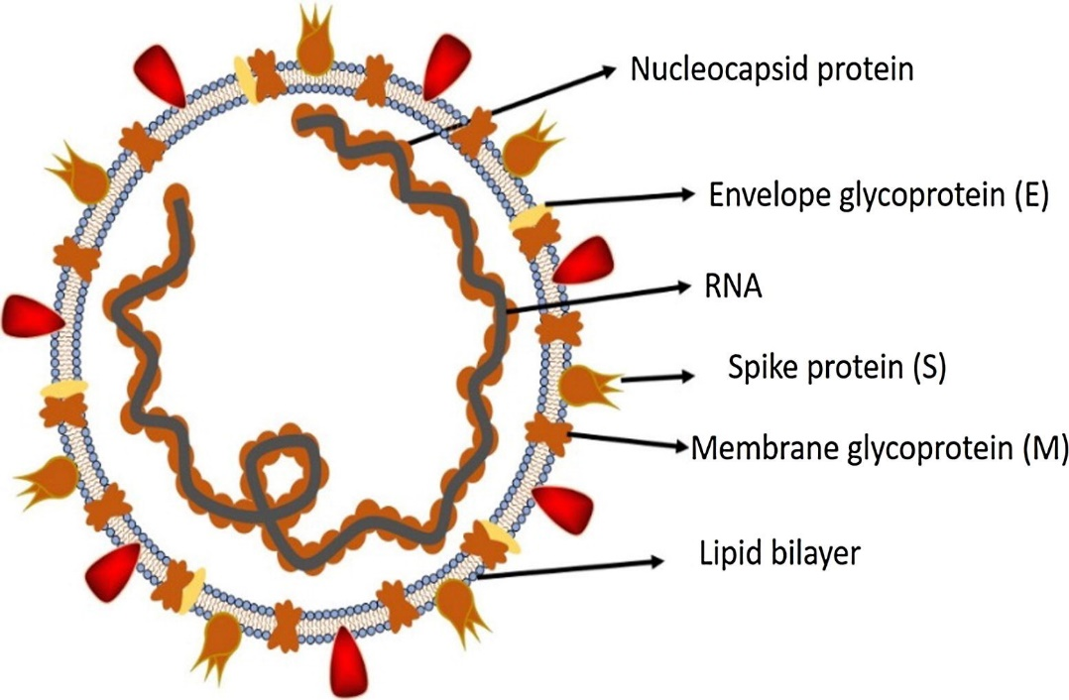
COVID- 19 epidemic – A coronavirus disease
SARS-CoV-2 is an RNA virus
Relates to SARS-CoV and MERS-CoV
Primary host ? bats
Intermediate host ? pangolins
Full genome published in GenBank
Several strains likely.
Shereen MA et al. J Adv Res. 2020 Mar 16;24:91-98.

Slide 8

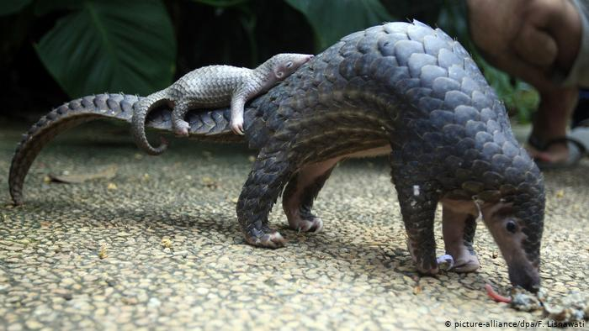
Hosts for SARS-CoV-2
Pangolins are the world’s most trafficked mammals

Slide 9
WHO declared global pandemic on 11th March 2020
Notes:
A pandemic is an epidemic occurring on a scale which crosses international boundaries, usually affecting a large number of people.

Slide 10
This is a new coronavirus, still evolving, and has put the scientific authority in a puzzle.
The number of affected cases and deaths both have become exponential during this pandemic.

Slide 11
Transmission
Man to man transmission
Mostly, droplet infection, also airborne
Direct contact, e.g., touching, shaking hands
Fomites, e.g., touching contaminated object
? Faecal-oral transmission

Slide 12
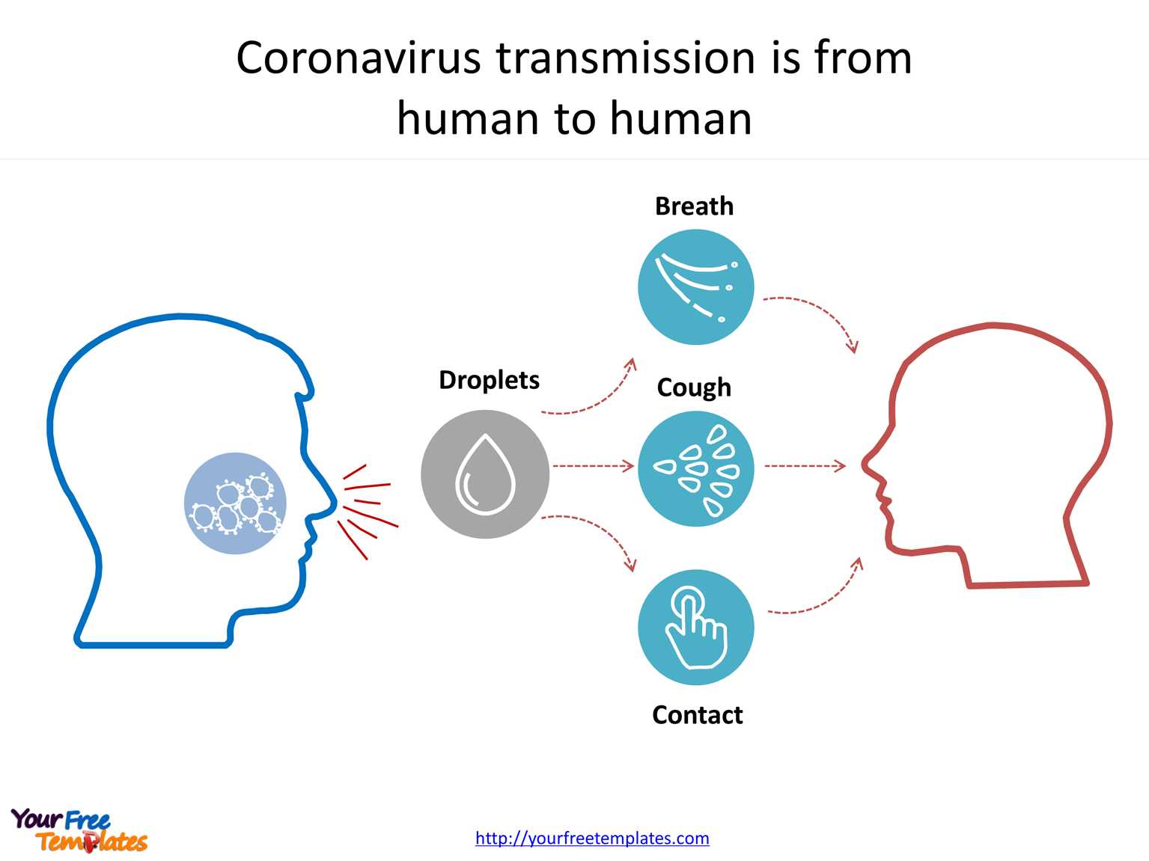
Transmission

Slide 13
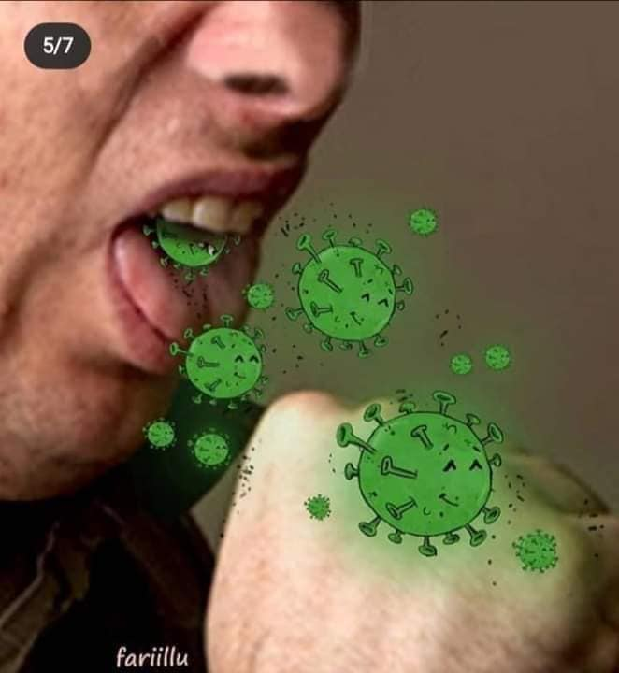
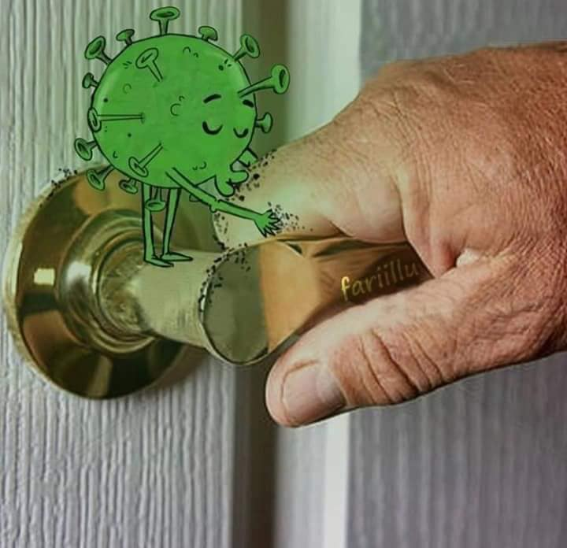
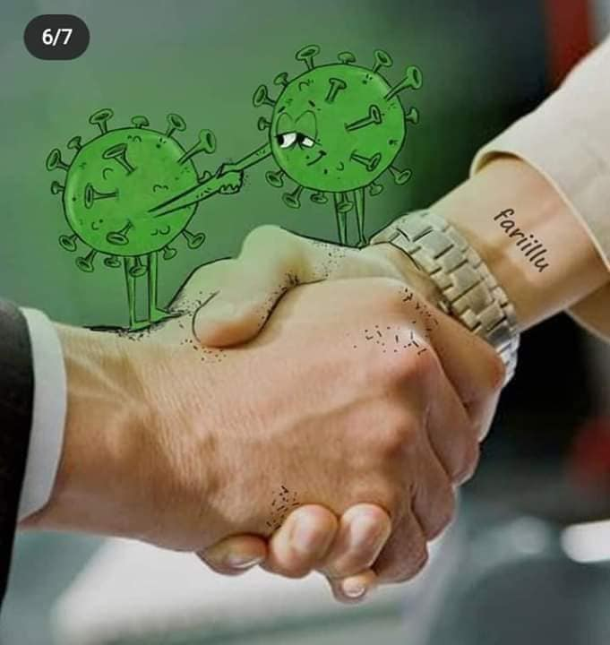

Slide 14
Incubation period
The WHO reported an incubation period for COVID-19 between 2 and 10 days.
China’s National Health Commission (NHC) had initially estimated an incubation period from 10 to 14 days.

Slide 15
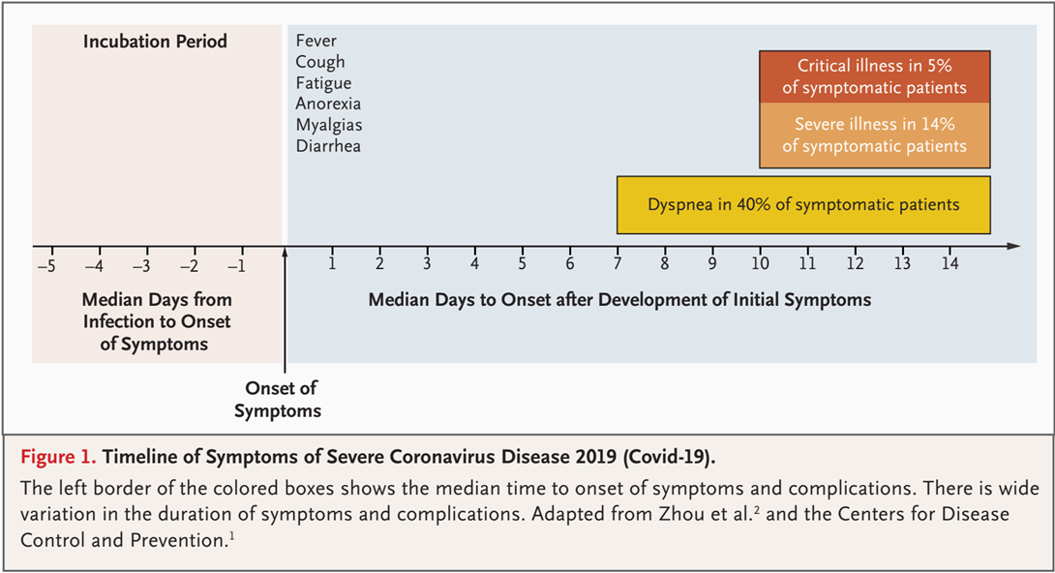
Timeline of Symptoms

Slide 16
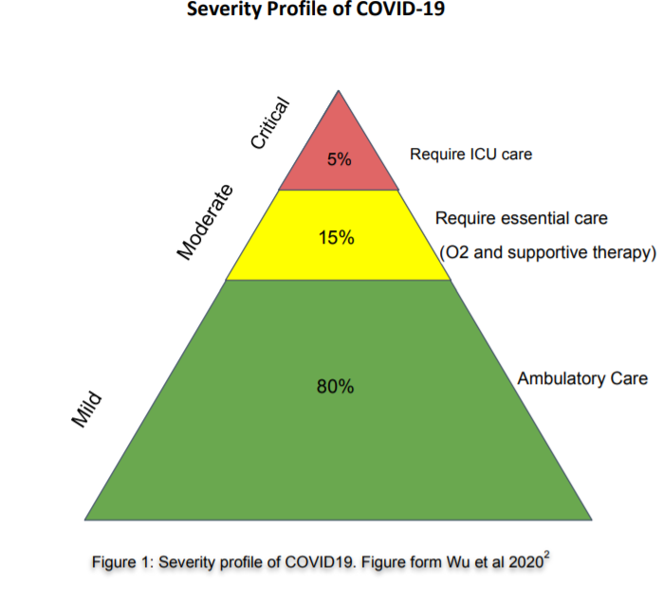

Slide 17

Case definition
Suspect
Probable
Confirmed

Slide 18
Suspect case
Acute respiratory illness, AND H/o travel to or residence in a country with COVID-19 disease during last 14 days.
OR,
Any acute respiratory illness AND contact with confirmed or probable COVID-19 case during last 14 days.
OR,
Severe acute respiratory illness AND no alternative diagnosis.

Slide 19
Probable case
Suspect with inconclusive COVID-19 test
OR,
Suspect, COVID-19 test could not be done.

Slide 20
Confirmed case
Case with laboratory confirmation of COVID-19 infection

Slide 21
Who is contact?
No symptoms, but exposed to probable or confirmed case within 2 days before and 14 days after onset of symptoms.
Contact pattern
  Face-to-face contact within 1 meter and for >15 minutes
  Direct physical contact
  Direct care of COVID-19 patient without proper PPE.

Slide 22
Clinical presentation

Slide 23
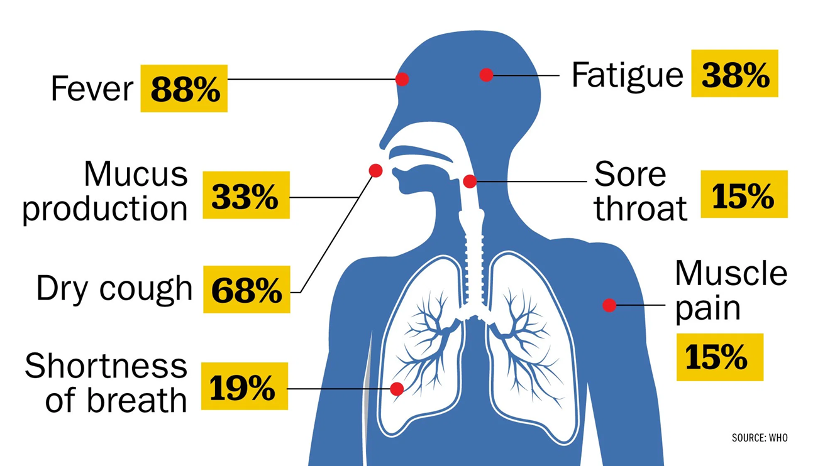
According to a study of nearly 56,000 laboratory confirmed cases cited in the WHO report, the most common symptom, experienced by 88% of confirmed patients, is a fever.

Slide 24
Disease manifestations
Asymptomatic (5%-80%)¹
Presymptomatic^{2,3}
  Initially asymptomatic (1-3 days), later develops symptoms
  Accounts for 6%-12% disease transmission
  To prevent transmission, limiting contacts may not be enough
  Supports social distancing, wearing surgical masks at population level.
Symptomatic
1. https://www.cebm.net/covid-19/covid-19-what-proportion-are-asymptomatic/
2. Wei WE, et al. MMWR Morb Mortal Wkly Rep. 2020 Apr 1. doi: 10.15585/mmwr.mm6914e1
3. Qian G, et al. Clin Infect Dis2020;ciaa316. doi:10.1093/cid/ciaa316

Slide 25
Clinical features
Cough and shortness of breath or difficulty breathing plus at least 2 may indicate COVID-19
Fever Chills Repeated shaking with chills Muscle pain | Headache Sore throat New loss of taste or smell
CDC. Symptoms of Coronavirus. CDC. Available at https://www.cdc.gov/coronavirus/2019-ncov/symptoms-testing/symptoms.html. March 20, 2020; Accessed: April 28, 2020.

Slide 26
High-risk features
Age ≥65 years
Nursing home or long-term care facility resident
Cardiac: Heart disease with complications
Immunocompromised: Including cancer treatment
Severe obesity: BMI ≥40
High risk Pregnancy
Comorbidities: Diabetes, renal failure, liver disease,HTN
Centre for Disease Control, USA

Slide 27
Clinical syndromes associated with
COVID-19 infection
Mild illness(ILI)
Pneumonia (Moderate)
Severe Pneumonia
Acute Respiratory Distress Syndrome
Sepsis
Septic shock

Slide 28
Severe pneumonia
Fever or suspected RTI, plus one of :
  Respiratory rate >30/min.
  Severe respiratory distress; or
  SpO₂ ≤93% on room air.

Slide 29
Acute respiratory distress syndrome (ARDS)
Acute onset (within 1 week)
Bilateral opacities on chest imaging (e.g., x-ray)
Impaired oxygenation: PaO₂/FiO₂ ≤300 mmHg
If no risk factors for ARDS, acute left ventricular failure should be ruled out.
ARDS Definition Task Force, Ranieri VM, et al. JAMA. 2012 Jun 20;307(23):2526-33.

Slide 30
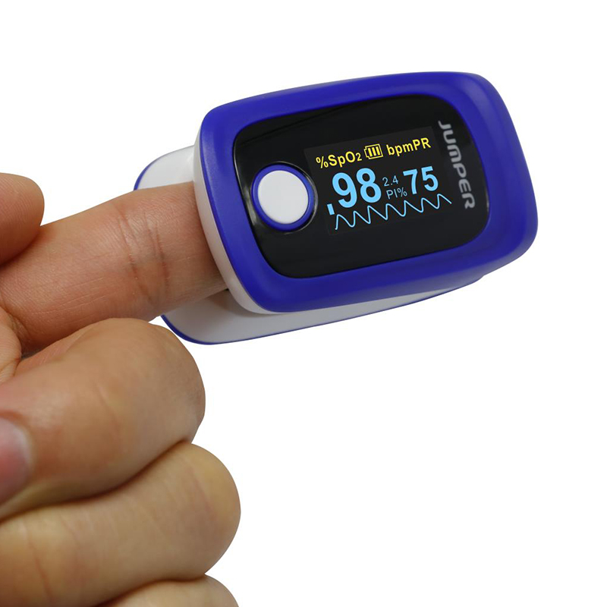
ARDS
When PaO₂ is not available:
  SpO₂/FiO₂ ≤315 mmHg suggests ARDS

Slide 31
ARDS: When to suspect?
Critically ill patient if having…..
  Dyspnoea, tachypnoea but
  Chest auscultation normal.
Udobi KF, et al. Am Fam Physician. 2003 Jan 15;67(2):315-22.

Slide 32
Sepsis: Life-threatening organ dysfunction by dysregulated host response to infection
Signs of organ dysfunction:
Laboratory evidence:
Altered mental status
Difficult or fast breathing
Low oxygen saturation
Reduced urine output
Tachycardia, small volume pulse, cold extremities or low BP, skin mottling
Coagulopathy
Thrombocytopenia <50,000/cmm
Raised serum lactate
Hyperbilirubinemia

Slide 33
Septic shock
Persisting hypotension despite volume resuscitation, requiring vasopressors to maintain MAP ≥65 mmHg and
Serum lactate level >2 mmol/L persisting after adequate fluid resuscitation.
Shankar-Hari M, et al., Sepsis Definitions Task Force. JAMA. 2016 Feb 23; 315(8):775-87.

Slide 34
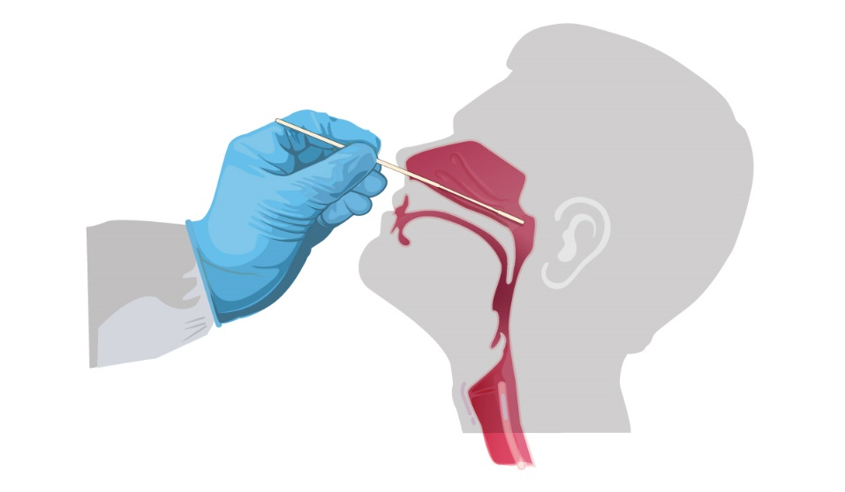
Investigations

Slide 35
Real-time RT-PCR test for SARS-CoV-2
All suspects should have RT-PCR
Gold standard
High specificity, low sensitivity (65-95%)
Specimen:
  Upper airway specimens: Nasopharyngeal swab (first choice), oropharyngeal swab
  Lower airway specimens: Bronchoalveolar lavage, tracheal aspirate, pleural fluid, lung biopsy, sputum

Slide 36
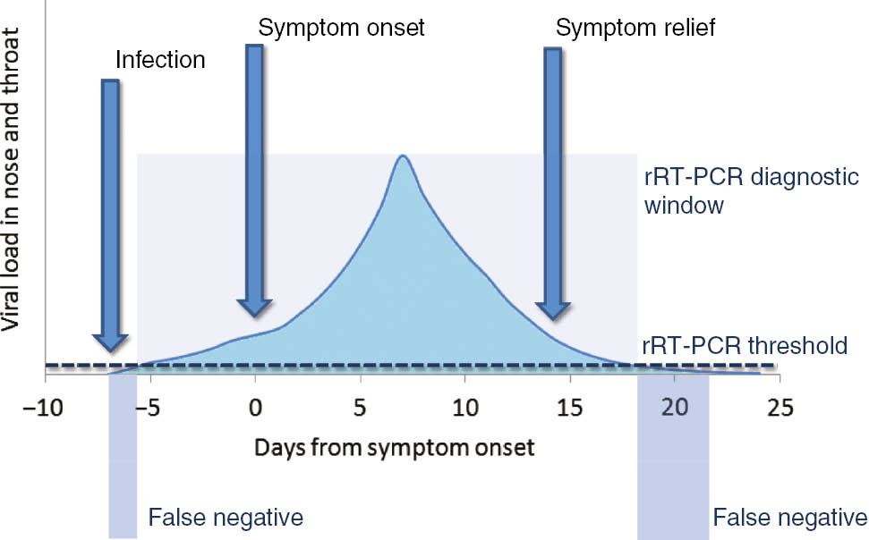
RT-PCR for SARS-CoV-2
Correspondence between viral load, disease progression and RT-PCR
RT-PCR in 56 confirmed COVID- 19 patients in China
Week | Positivity
1 | 100%
2 | 89.3%
3 | 66.1%
4 | 32.1%
5 | 5.4%
6 | 0%
Lippi G, et al. Clin Chem Lab Med. 2020 Mar 16. pii: /j/cclm.ahead-of-print/cclm-2020-0285/cclm-2020-0285.xml.
Xiao AT et al. Clin Infect Dis. 2020 Apr 19. pii: ciaa460. doi: 10.1093/cid/ciaa460.

Slide 37
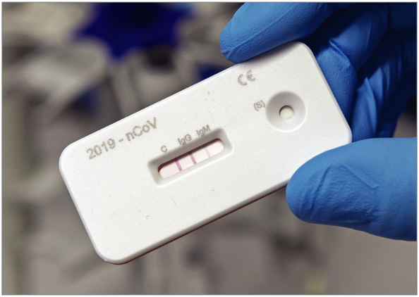
Serological tests for SARS-CoV-2
Still evolving
Low sensitivity, good specificity
Still not recommended by WHO
CDC, USA has granted EUA
May be important for sero-surveillance
Gonoshasthaya's Rapid Dot Blot testing kit is under trial by ICDDR,B

Slide 38
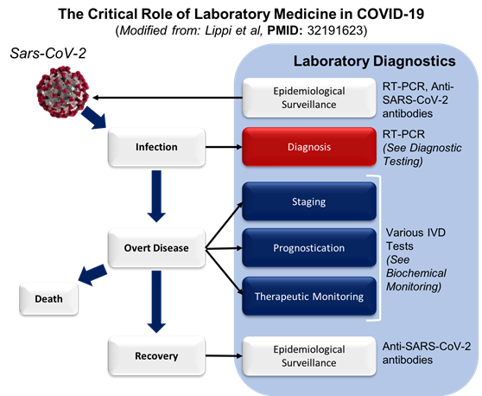
Current status of COVID- 19 tests

Slide 39
Current status of COVID- 19 tests
Test | Specimen | POC use | Interpretation | Use
NAAT (RT-PCR) | NP swab, BAL, sputum, blood, faeces | No | Confirms current infection | Individual testing
Ab-based immunoassay | Serum | Yes | Ig M 3-5 days of onset; Ig G past infection | Community surveillance
Ag-based immunoassay | NP swab, BAL, sputum, blood, Saliva | Yes | Confirms current infection | Individual testing
Clinical tests | CT chest | Yes | Infection possible | Triage
ESC Guidance for the Diagnosis and Management of CV Disease during the COVID-19 Pandemic. Available at: https://www.escardio.org/Education/COVID-19-and-Cardiology/ESC-COVID-19-Guidance

Slide 40
Other investigations
Blood tests:
  CBC: Lymphopenia;
  N:L >3.5 bad prognosis
  CRP: Raised
  Serum procalcitonin: Normal
  Serum ferritin: Raised
  Serum LDH: Mildly raised
  Serum D-dimer: Raised
Imaging: Atypical pneumonia
  Chest x-ray
  HRCT scan of chest
  USG of chest
Serological tests for SARS-CoV-2
  Still evolving
Viral culture

Slide 41
CT scan of chest
Should not be relied upon for diagnosis and screening
High sensitivity (94%) but low specificity (37%)
Commonest: Ground-glass opacities -- bilateral, subpleural, peripheral
Others:
  Crazy paving appearance (ground-glass opacities plus inter-/intra-lobular septal thickening)
  Consolidation
  Vascular dilatation
  Traction Bronchiectasis
  Subpleural bands and architectural distortion
https://radiologyassistant.nl/chest/lk-jg-1

Slide 42
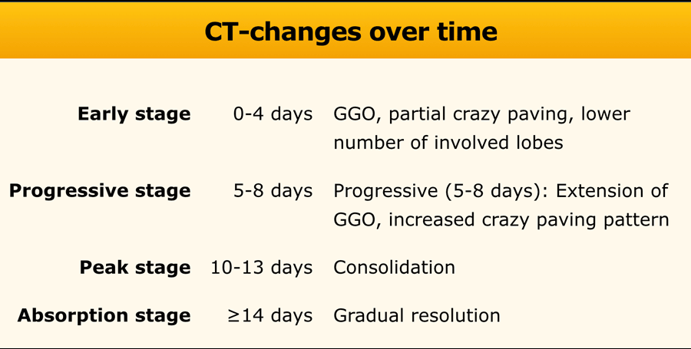
https://radiologyassistant.nl/chest/lk-jg-1

Slide 43
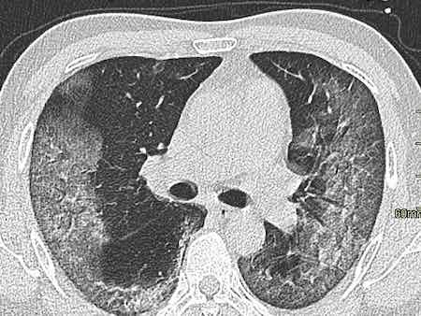
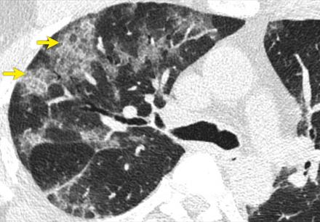
CT scan of chest in COVID- 19
Ground glass opacity
Crazy paving
https://radiologyassistant.nl/chest/lk-jg-1

Slide 44
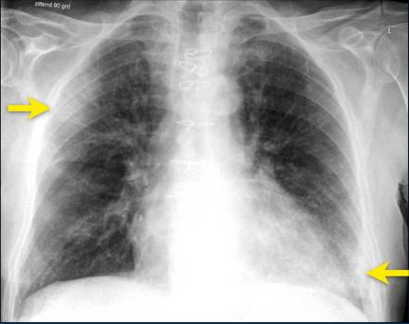
Chest x-ray
Typically, first-line imaging modality
Less sensitive than CT scan of chest
Commonest: Consolidation
Less common: Ground glass opacity
Bilateral, peripheral, lower zone predominant
Pleural effusion rare.
Ground-glass opacification and consolidation in right upper lobe and left lower lobe (arrows).
https://radiologyassistant.nl/chest/lk-jg-1

Slide 45
Chest x-ray in COVID- 19
Bilateral pneumonia
ARDS
National Guidelines on Clinical Management of Coronavirus Disease 2019(Covid-19), Version 5.9 April 2020, Government of the People's Republic of Bangladesh.

Slide 46
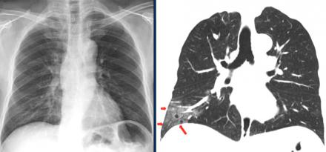
CXR vs. CT scan of chest
Ground glass opacities in right lower lobe on CT (red arrows) are not visible on chest radiograph, which was taken 1 hour prior to CT-study.
https://radiologyassistant.nl/chest/lk-jg-1

Slide 47
Even before RT-PCR is available…..
Ancillary tests can help!
Normal or low WBC count, lymphopenia, high CRP, low procalcitonin If associated with bilateral pneumonia in CXR or ground-glass opacity in CT chest diagnosis is COVID 19 during ongoing pandemic.
Serological test specially antigen-based test can be a POC test.

Slide 48
Management

Slide 50
No specific treatment
Management mostly symptomatic & supportive

Slide 51
Clinical criteria for case management
Stage of illness | Definition
Mild | Influenza like illness (ILI)
Moderate | Pneumonia (CRB 65 score 0)
Severe | Severe pneumonia, sepsis
Critical | ARDS, septic shock

Slide 52
Where to manage?
Stage of illness | Definition | Place of care
Asymptomatic | No symptoms | Home, ?Tele- medicine
Mild | Influenza like illness (ILI) | Home
Moderate | Pneumonia (CRB 65 score 0) | Home
Severe | Severe pneumonia, sepsis | Hospital, preferably, HDU
Critical | ARDS, septic shock | Hospital, preferably, ICU

Slide 53
Hospital admission criteria for COVID- 19
All COVID-19 cases (suspect/confirmed) presenting with
  Pneumonia with CRB 65 score ≥1
  Severe Pneumonia
  ARDS, sepsis, septic shock
  Hypoxia (SpO₂ <94%) even in absence of clinical signs
All cases of respiratory distress for evaluation and testing

Slide 54
After evaluation and testing for respiratory distress, non-COVID-19 cases are to be sent to non-COVID ward/hospitals.

Slide 55
Mild cases (Influenza-like illness)
Self-isolation at home (if not possible, institutional isolation)
Symptomatic treatment: Paracetamol, antihistamine
Azithromycin
  500mg once on D1, then 250mg on D2 to D5.

Slide 56
Self-home isolation for 14 days after clinical recovery
When to seek hospital care?
  Respiratory distress
  Worsening cough and fever
  Altered mental status
  Extreme lethargy

Slide 57
Moderate cases (Pneumonia)
Treatment as for mild cases
PLUS
Oral antibiotics as for uncomplicated community acquired pneumonia
Favipiravir 1600 mg stat, 600 mg bd 7-10 days. Efficacy doubtful.
Thromboprophylaxis with LMW heparin ( 1 mg/kg BW)
DOAC – Rivaroxavan 10 – 20 mg/ day 2 -4 weeks

Slide 58
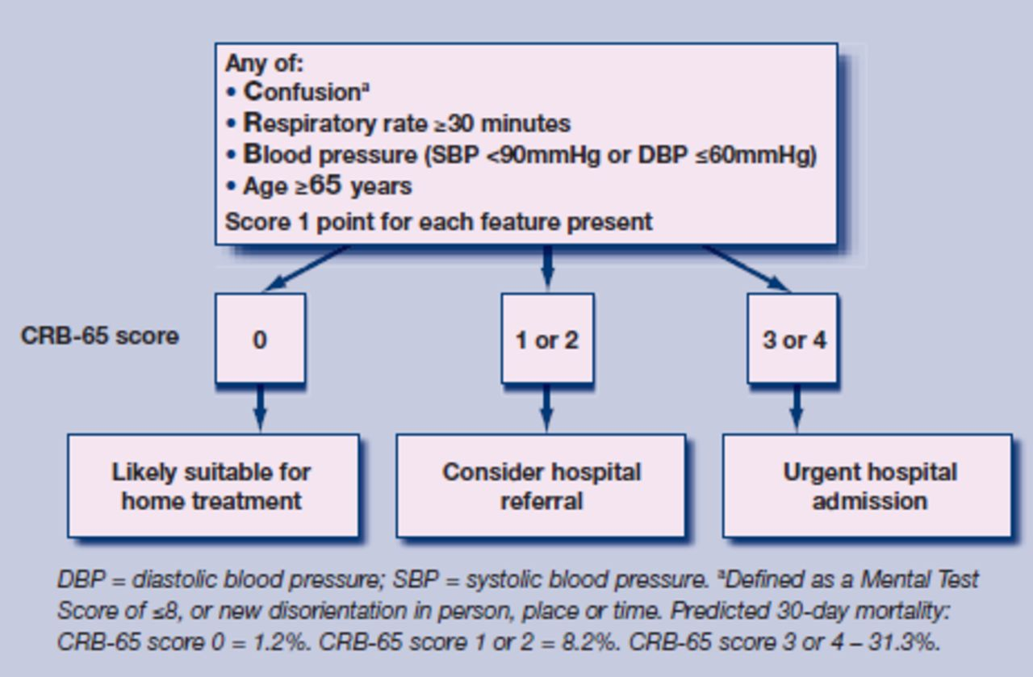
CRB 65 scoring system

Slide 59
Severe cases (Severe pneumonia, sepsis)
Supplemental oxygen:
  If SpO₂ <94%; respiratory rate >30/minute; shock
  Oxygen at 5 litres/min, titrated to target SpO₂ >94%
Empirical antibiotics Injectables
Inj.. Ramdisivir 200 mgstat, 100 mg daily -5 days
Thrombolysis with LMW heparin ( 1 mg/kg BW bd)
Management of co-morbid conditions

Slide 60
Critical cases (ARDS, septic shock)
Ventilation:
  Immediate supplemental oxygen, if SpO₂ <94%; high flow nasal canula preferable
  Mechanical ventilation in prone position
Haemodynamic support: Target MAP of 60-65 mmHg.
  Conservative fluid strategy, crystalloids preferable
  Inotropes: norepinephrine (first line), vasopressin (second line)
Empirical antibiotics
Steroid, if septic shock, ARDS ( Inj. Dexamethasone 10 -20 mg/d
Thrombolysis with LMW heparin ( Full dose- 14 days)

Slide 61
COVID patient’s Oxygen Delivery Algorithm
Aim: SpO2 90-96%%
Device: Nasal prongs, Face mask/ NRB Mask
Starts oxygen 2-6 l/min through nasal prongs
Asses response for 10-15min to keep Spo2 >90%
If increasing respiratory distress
or SpO2 < 90% (88% in COPD)
Starts oxygen 6-10 l/min through Face mask
Asses response for 10-15min to keep Spo2 >90%

Slide 62
If increasing respiratory distress
or SpO2 <90% (<88% in COPD)
Start Proning breathing along with supplement oxygen 10-15 l/min through Face mask/NRB mask
Asses response for 10-15min to keep Spo2 >90%
If still increasing respiratory distress
or SpO2 <90% (<88% in COPD)
or patient is exhausted HFNC is urgently needed ( 40 -50L) /minute, if all these fail only then
Refer the patient to ICU for Ventilator assistance

Slide 63
Hospital discharge criteria
Resolution of fever without antipyretics for 72 hours AND
Significant improvement of respiratory symptoms AND
After discharge, home (or, institutional) isolation for 10 days.
Discharge criteria for COVID- 19 patients. Directorate General of Health, Government of the People's Republic of Bangladesh, 28 May, 2020

Slide 64
Post-discharge care
Home isolation
Avoid contact with infants, elderly
Wearing masks and frequent hand washing by patient and family members
Monitoring of patient's condition.

Slide 65

Return to work criteria for HCW
Symptomatic, confirmed or suspected HCW: 2 strategies:
  Test-based strategy (preferable)
  Non-test-based strategy
Test-based strategy. Exclude from work until
  Resolution of fever and
  Improvement in respiratory symptoms (e.g., cough, SOB), and
  10 -14 Isolation
https://www.cdc.gov/coronavirus/2019-ncov/hcp/return-to-work.html?CDC_AA_refVal=https%3A%2F%2Fwww.cdc.gov%2Fcoronavirus%2F2019-ncov%2Fhealthcare-facilities%2Fhcp-return-work.html.

Slide 66
Non-test-based strategy. Exclude from work until
  At least 3 days have passed since recovery defined as resolution of fever and improvement in respiratory symptoms (e.g., cough, SOB); and,
  At least 10 days have passed since symptoms first appeared.
Asymptomatic, ‘confirmed’ COVID- 19 HCW:
  10 days from first positive test.
https://www.cdc.gov/coronavirus/2019-ncov/hcp/return-to-work.html?CDC_AA_refVal=https%3A%2F%2Fwww.cdc.gov%2Fcoronavirus%2F2019-ncov%2Fhealthcare-facilities%2Fhcp-return-work.html.

Slide 67
Return to work practices
Wearing facemask till complete resolution of all symptoms or 14 days after illness onset, whichever is longer.
Avoidance of contact with severely immunocompromised patients (e.g., transplant, haematology-oncology) for 14 days after illness onset
Self-monitor and re-evaluation if respiratory symptoms recur or worsen.
https://www.cdc.gov/coronavirus/2019-ncov/hcp/return-to-work.html?CDC_AA_refVal=https%3A%2F%2Fwww.cdc.gov%2Fcoronavirus%2F2019-ncov%2Fhealthcare-facilities%2Fhcp-return-work.html.

Slide 68
Emerging treatment
Remdesivir: FDA approved (available in Bangladesh )
Favipiravir: Available in Bangladesh
Convalescent plasma
Tocilizumab

Slide 69

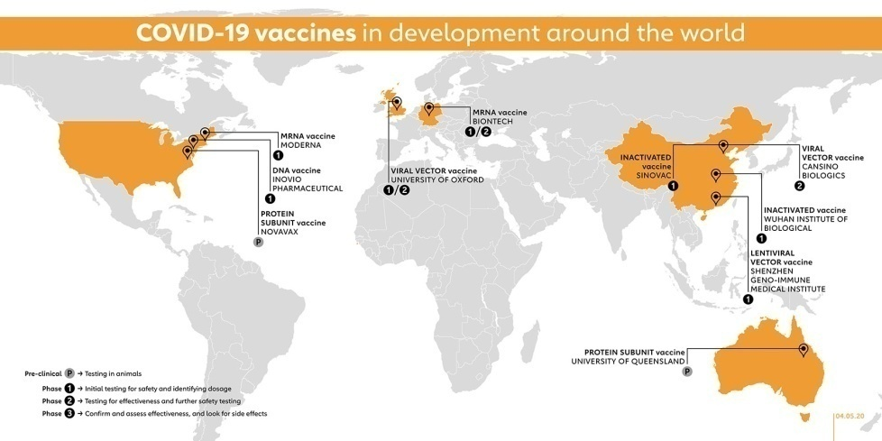
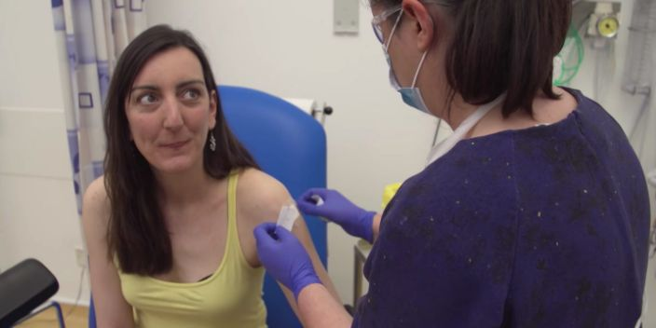
Vaccine
More than 175 now
Degree and duration of protection in doubt
CanSino Biologics Inc. viral vector vaccine, China (Phase 2)
University of Oxford’s viral vector vaccine, UK (Phase 1/ 2)
Biontech’s mRNA vaccine, Germany (Phase 1/ Phase 2)
Moderna’s mrna vaccine, USA (Phase 2)
The Global Alliance for Vaccines and Immunisation. https://www.gavi.org/vaccineswork/covid-19-vaccine-race, accessed 10 June.
Dr. Elisa Granato, the first human to receive hAdOx1 nCoV-19 vaccine from Oxford Vaccine Group.

Slide 70
Chemoprophylaxis
Indicated for: Asymptomatic healthcare workers involved in care of suspected or confirmed COVID-19 cases
Regimen:
  Hydroxychloroquine (HCQ): 400 mg twice daily on Day 1, followed by 400 mg once weekly for next 7 weeks
Pre-existing heart disease: ECG before HCQ and to be repeated every week.

Slide 71
COVID- 19 and special SITUAtions

Slide 72
COVID-19-associated coagulopathy vs. DIC
Trait | COVID-19-associated coagulopathy | DIC
Platelet count | Mildly reduced (~100 x10⁹/L) | Markedly reduced (<50 x10⁹/L)
D-dimer | Elevated | Elevated
Fibrinogen | Elevated | Decreased
aPTT and PT prolongation | Both prolonged, aPTT < PT | Both prolonged
Microangiopathy | Absent | Present
Bleeding | Less common | More common

Slide 73
Thromboprophylaxis in COVID- 19 illness
Indicated in all hospitalized patients without active bleeding
Held if platelet count <25 x 10⁹/L, or fibrinogen <0.5 g/L
Abnormal PT or aPTT is not a contraindication
Mechanical thromboprophylaxis if pharmacological one contraindicated
LMW heparin is favoured, ? Intermediate intensity
Rivaroxaban 10 mg daily for ?3 months for post-discharge prophylaxis
Aspirin may be for low-risk patients post-discharge.
American Society of Hematology on COVID- 19. Available at: https://www.hematology.org/covid-19/covid-19-and-vte-anticoagulation

Slide 74
British Thoracic Society guidance on VTE in COVID-19
VTE risk | Anticoagulation regimen
Standard risk (D-Dimer <1,000mcg/L) | Standard prophylactic dose LMWH: Enoxaparin 40 mg once daily
High risk (D-Dimer <1,000-3,000mcg/L) | Intermediate dose LMWH: Enoxaparin 40 mg twice daily
Acute VTE, proven or suspected (D-Dimer <3,000mcg/L) | Therapeutic dose LMWH Anticoagulation for 3 months.
https://www.google.com/url?sa=t&rct=j&q=&esrc=s&source=web&cd=2&cad=rja&uact=8&ved=2ahUKEwjD9av_75fpAhUTxzgGHaDDAWQQFjABegQIAxAB&url=https%3A%2F%2Fwww.brit-thoracic.org.uk%2Fdocument-library%2Fquality-improvement%2Fcovid-19%2Fbts-guidance-on-venous-thromboembolic-disease-in-patients-with-covid-19%2F&usg=AOvVaw1wijaI_6yIc_iYAM2V6TfV

Slide 75
COVID- 19 and hypertension
Should be diagnosed and treated as per current guidelines
ACE inhibitors and ARBs should be continued
ARBs or ACE inhibitors should not be started for cardio-protection.

Slide 76
COVID- 19 and heart failure
Should be diagnosed and treated as per current guidelines
ACE inhibitors and ARBs should be continued
ARBs or ACE inhibitors should not be started for cardio-protection
ARNI should be used as per current guidelines

Slide 77
COVID- 19 and ACS
Should be diagnosed on the basis of clinical presentation, ECG features, and raised biomarkers
Elevated troponin in isolation, may indicate myocardial injury, not AMI
Thrombolytic therapy may be the practical reperfusion strategy
Primary PCI should only be done if dedicated cath lab and adequate protection can be ensured
Standard pharmacological therapy is advocated.

Slide 78
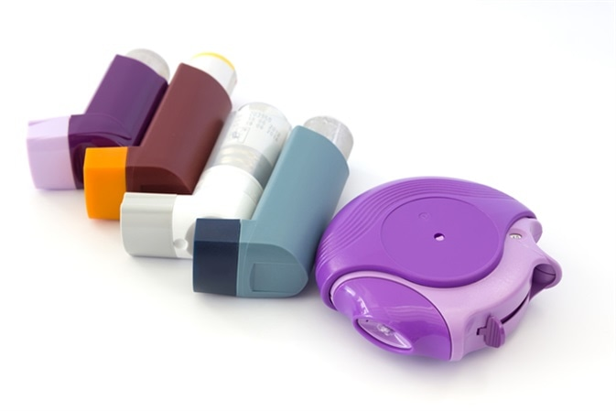
COVID- 19 and bronchial asthma
Standard guideline should be followed
Inhalers with spacers should be continued as usual
Steroid as inhalers and rescue therapy are not contraindicated

Slide 79

COVID- 19 and DM
Insulin: Should not be stopped
DPP4 inhibitors e.g., linagliptin, sitagliptin: Well tolerated
Metformin: Should be stopped; dehydration and lactic acidosis
SGLT2 inhibitors e.g., empagliflozin: Should be stopped, risk of dehydration and DKA
GLP-1 receptor agonists, e.g., liraglutide: Dehydration likely
Bornstein SR et al. Lancet Diabetes Endocrinol. 2020 Apr 23.
pii: S2213-8587(20)30152-2. doi: 10.1016/S2213-8587(20)30152-2.

Slide 80


COVID- 19 and mental health
A medical worker is seen sitting in the East Village of China during the coronavirus pandemic
Dr. Lorna M. Breen, medical director at NewYork-Presbyterian Allen Hospital, committed suicide.

Slide 81


Slide 82
IPC (Infection prevention control)

Slide 83
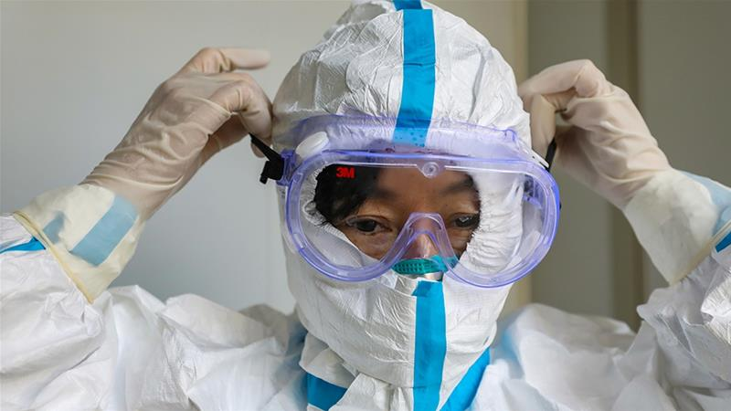
Personal Protective Equipment for Health Care Worker
The rational, correct, and consistent use of PPE also helps to reduce the spread of pathogens
The use of PPE effectiveness strongly depends on
adequate and regular supplies,
adequate staff training,
appropriate hand hygiene and
specifically appropriate human behavior

Slide 85
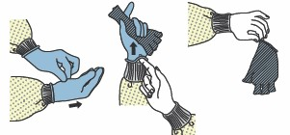

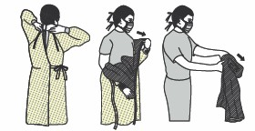

Slide 86


Slide 87
Things to do:
Wash your hands frequently
If possible, keep a distance of 1-metre between yourself and patient who is suspected.
Avoid touching your mouth,eyes and nose. (MEN)
If you start coughing, sneezing or develop fever after you have provided care, report your illness immediately to the concerned authority and follow their advice
If equipment needs to be shared among patients, clean and disinfect between each patient use.
Avoid contaminating environmental surfaces that are not directly related to patient care (e.g. door handles and light switches).

Slide 88
Environmental cleaning & Disinfection:
Environmental cleaning and disinfection procedures are followed consistently and correctly.
Thoroughly cleaning environmental surfaces with water and detergent and applying commonly used hospital-level disinfectants (such as sodium hypochlorite) are effective and sufficient procedures.
Medical devices and equipment, laundry, food service utensils and medical waste should be managed in accordance with safe routine procedures.

Slide 89
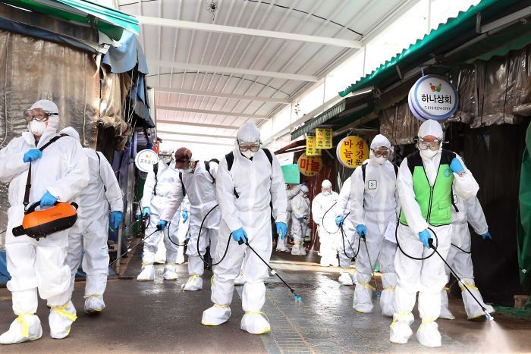
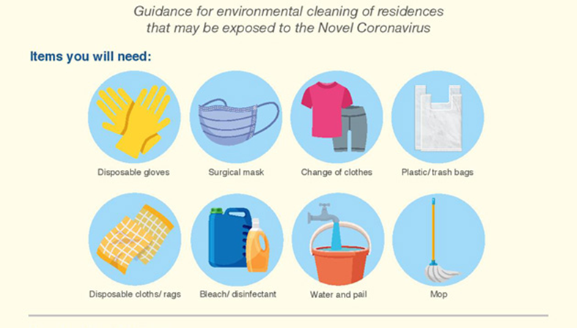

Slide 90
Clinical triage
A system for assessing all patients at admission allowing early recognition of possible COVID-19 patients and
immediate isolation of patients with suspected COVID-19 infection in an area separate from other patients (source control).

Slide 91
Objectives:
• To facilitate the early identification of cases of suspected COVID-19
• Separation of suspected COVID-19 from general patients to limit the transmission of infect
Target population
• COVID 19 suspected case (fever, cough with or without respiratory distress and travel/exposure history)

Slide 92
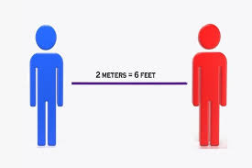
Physical Distancing

Slide 93
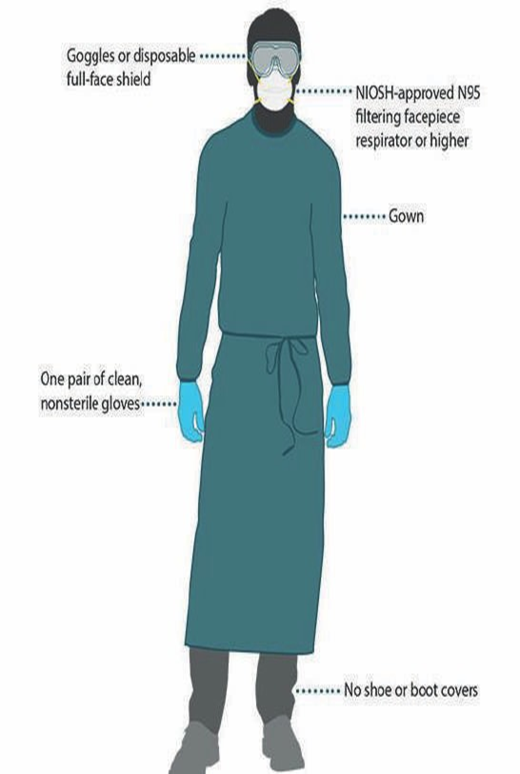
PPE

Slide 94
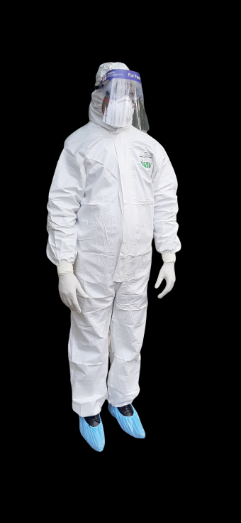

Slide 95
What is the recovery time for the coronavirus disease?
Using available preliminary data, the median time from onset to clinical recovery
for mild cases is approximately 2 weeks and
is 3-6 weeks for patients with severe or critical disease.

Slide 96
When the patients are free to break quarantine?
only if:
they have had no fever for at least 72 hours without the aid of fever-reducing medications
all other symptoms like coughing and shortness of breath have improved
and at least 10 days have passed
In severe cases – discretion of the Consultant
Recovery consecutive 2 tests are not needed.

Slide 97
Take-home message
An RNA virus disease, mainly spread by respiratory droplets
Majority experiences mild to moderate respiratory illness
RT-PCR is the gold standard test
Management is symptomatic and supportive
Thromboprophylaxis for all hospitalized COVID- 19 patients
Remdisivir has EUA by FDA
Home management is for asymptomatic, mild and moderate diseases
Hospital management is indicated for severe and critical diseases
Vaccines are in up to phase 2 trial
Prognosis appears better than SARS, MERS, and Ebola.

Slide 98

Praying For THE World

Slide 99
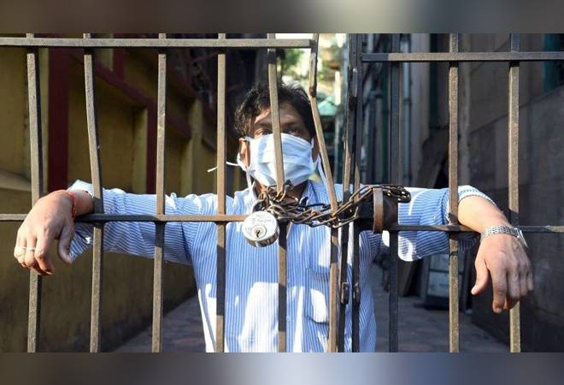



Thank you

